Slide 1
Mechanisms and Robotics DE ES ZG561
Lecture-15

Slide 2
Contents
Robot Programming
Lead-Through Programming
Textual Language Programming
Robot Programming Languages
Compliance
Active Vs. Passive Compliance
Remote Centre Compliance Devices
Part Presentation Methods
Bowl Feeders
Magazine Feeders

Slide 3
Robot Programming
Lead Through Programming
Lead-through methods require the programmer to move the manipulator through the desired motion path and the path is recorded in the memory of the robot controller
Manual Lead-through
Powered Lead-through
Textual Language Programming
Robot programming with textual languages is accomplished just like computer programming.
The programmer types the program in an English-like language.
The procedure is augmented with by lead-through methods to teach the robot the locations of points in the workspace.

Slide 4
Lead-Through Programming
The robot arm is moved through the required sequence of motions by the operator and the path is saved and played back.
Commands are also used in Lead-through programming to provide interlocks.

Slide 5
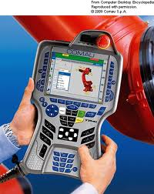
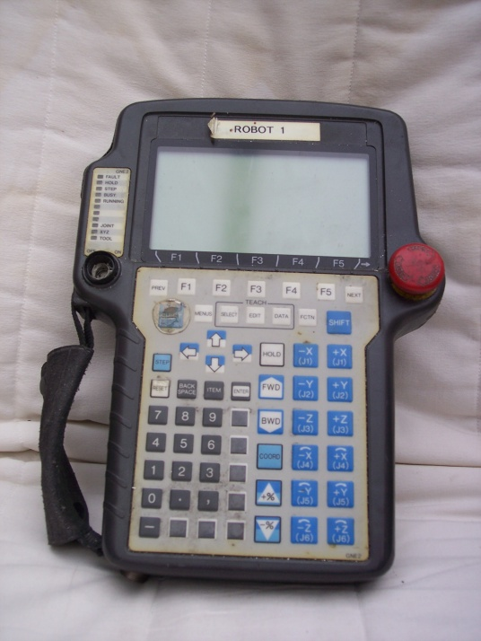
Teach Pendant

Slide 6
Interpolation Schemes
On many robots the programmer can specify which interpolation scheme to use, The possibilities include
Joint Interpolation
The controller will choose a joint interpolated path between two points (unless a straight line is specified)
Straight Line Interpolation
The path between the points is a straight line
Circular interpolation
This is done by specifying three points that lie along a circle.
The controller constructs an approximation of a circle by selecting a series of addressable points that lie close to the defined circle.
The movement made by the robot consist of short straight-line segments.
Irregular smooth motions
movements in manual lead-through typically used for arc welding and spray painting, consisting of straight lines and curves.

Slide 7
Advantages of Lead-through method
No Computer Programming.
Logical way to teach a robot.
Easy to use by shop floor personnel.

Slide 8
Commands used In Lead-through Programming
SIGNAL M – Instructs the robot controller to output a signal through line M.
WAIT N – The robot should wait at the current location until it receives a signal on line N
DELAY X SEC – The robot should wait X seconds before proceeding to the next step in the program.

Slide 9
Limitations of Lead-through methods
The robot cannot be used in production while it is being programmed.
This has economic implications
If the lot size is small, it takes longer to program than to run
As the complexity of the program increases, it becomes more difficult to accomplish lead-through programming.
Lead-through programming is not readily compatible with modern computer based technologies like CAD/CAM, data communications, networking etc
Poses problems with interfacing robots with other computer based systems

Slide 10
Textual Programming Languages
English-like Commands are used similar to Computer programming.
History:
WAVE was the first Robot programming language developed, in 1973 by Stanford University Artificial intelligence Laboratory.
Robot was interfaced with a machine vision system using Wave
AL Was another Language developed by Stanford in 1974
Could control multiple arms where arm coordination was needed.
VAL (Victors’ Assembly Language named after victor scheinman)
VAL was the first commercially available robot textual language introduced by Unimation in 1979.
IBM introduced two languages in 1982
AUTOPASS – Automatic Parts assembly system.
AML – A Manufacturing Language

Slide 11
Robot Programming Languages
First Generation Languages:
Use a combination of command statements and teach pendant procedures for developing programs.
Used mainly to accomplish motion control using a textual language, Also referred to as motion level languages.
Features:
Ability to define manipulator motions
Use statements to define motions and teach pendant to define points locations.
Example: VAL
Limitations:
Inability to specify complex arithmetic computations
Inability to use complex sensors and sensor data
Limited capacity to communicate with other computers
Cannot be extended or upgraded for future enhancements

Slide 12
Robot Programming Languages
Second Generation Languages:
Examples
AML, RAIL, MCL, VAL II
Features
Motion Control
Advanced Sensor Control
Use of Analog signals
Can control gripper forces based on sensor inputs
Limited Intelligence
The robot can deal with small irregularities occurring in the work cycle.
The robot can do beyond what it is just programmed to do.
Communications and data processing.
Production records
Performance reports
Controlling activities in the work cell

Slide 13
Robot Programming Languages
Future Generation Languages:
Based on a concept called world modeling.
The robot possesses knowledge of the three-dimensional world and is capable of generating a step by step procedure to perform a task once the objective is given.

Slide 14
VAL II
Motion Commands
MOVE P1
To move the robot arm by a joint interpolated motion to the point P1.
MOVES P1
To move the robot arm along a straight line from the current location to the point P1.
APPRO P1, 50
Moves the tool to position and orientation specified by P1 but offset from the point along the tool z-axis by a distance of 50 mm.
DEPART 50
Moves the tool away from P1 by 50 mm along the tool z-axis

Slide 16
VAL II
Defining Locations
HERE P1
DEFINE A1 = POINT<x,y,z,Wr1,Wr2>
First three are x, y, z coordinates, last two are wrist rotation angles
DEFNE PATH1 = PATH (A1,A2, A3, A4)
MOVE PATH1
MOVE A1 VIA A2
Tells the robot to move its arm to point A1, but pass through A2 while making the move.

Slide 17
VAL II
Gripper Commands
OPEN
CLOSE
Speed Specification
SPEED 60 – 60% of speed specified in the monitor speed command
SPEED 15 IPS – 15 inches per second
SPEED 150 MMPS – 150 mm per second

Slide 19
Current Trends in Robot Programming Languages
ABB uses its RAPID programming language
Kuka uses KRL (Kuka Robot Language)
Comau uses PDL2
Yaskawa uses INFORM
Kawasaki uses AS.
Fanuc robots use Karel
Stäubli robots use VAL3
Universal Robots use URScript.

Slide 20
Compliance
A Non-Compliant (stiff actuator) is a device, which is able to move to a specific position or to track a predefined trajectory - Once a position is reached, it will remain at that position, whatever the external forces exerted on the actuator (within the force limits of the device)
A compliant actuator will allow deviations from its own equilibrium position, depending on the applied external force. The equilibrium position of a compliant actuator is defined as the position of the actuator where the actuator generates zero force or zero torque. This concept is specifically introduced for compliant actuators.

Slide 21
Active Vs. Passive Compliance
Passive compliant actuators contain an elastic element, e.g. a spring which can store energy.
In a Manipulator with Active compliance, the controller of a stiff actuator mimics the behavior of a spring
The Active compliant manipulator has the disadvantage that no energy can be stored in the actuation system and due to the limited bandwidth of the controller, no shocks can be absorbed

Slide 22
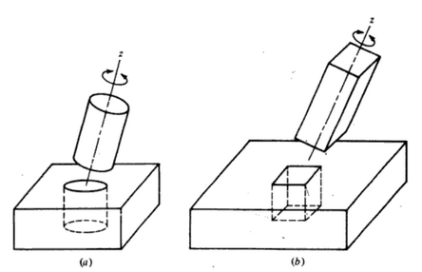
Operations where compliance is required

Slide 23
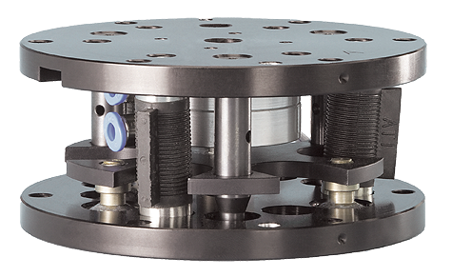
Remote Centre Compliance Device (RCC)
The Remote Center Compliance (RCC) device is a mechanical device which acts as a multi-axis float to achieve lateral and angular alignment between components which are being mated during assembly operations.
The RCC device was developed in Charles Stark Draper Laboratory in Cambridge Massachusetts, USA.
RCC Products are commercially available.
The device is typically mounted between the wrist of a robot and its gripper.
The RCC device is capable of accommodating the lateral and angular errors encountered in an insertion operation and related tasks.

Slide 24
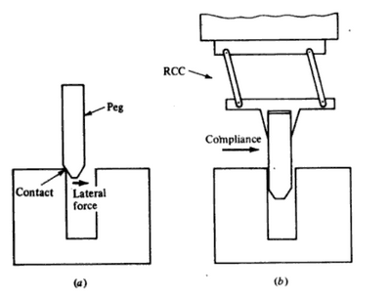
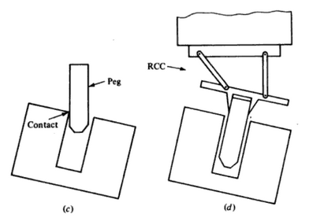
Operations where compliance is required

Slide 25
Selection of a Remote Centre Compliance Device
Remote Centre Distance: It is the distance between the RCC bottom surface and the compliant centre of the RCC device.
(The compliant centre is also called the elastic centre is the point about which the forces acting on the object being inserted are minimum.)
Axial Force Capacity: This is the maximum force in the axial direction which the RCC device is designed to withstand and still function properly.
Compressive Stiffness: This is also called the axial stiffness. It is the force per unit distance or spring constant required to compress the RCC device in the direction of insertion. Generally compressive stiffness is very high to allow press fitting of parts.
Lateral Stiffness: This is the spring constant relating to the force required to deflect the RCC perpendicular to the direction of insertion.
Angular Stiffness: This is also called cocking stiffness. It is the rotational spring constant that relates to the force required to rotate the part about the elastic centre by a certain amount.
Torsional stiffness: This is the torsional spring constant which relates to the moment required to rotate the part about the axis of insertion.

Slide 26
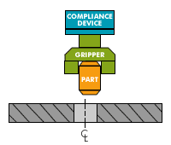
Remote Centre Compliance Device (RCC)
The Remote Center Compliance (RCC) device is a mechanical device which acts as a multi-axis float to achieve lateral and angular alignment between components which are being mated during assembly operations.

Slide 27
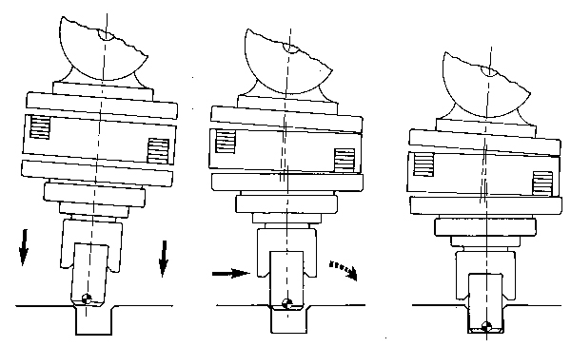
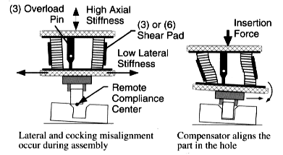
Remote Centre Compliance Device - Working
RCC device compensating Angular and axial misalignments

Slide 29
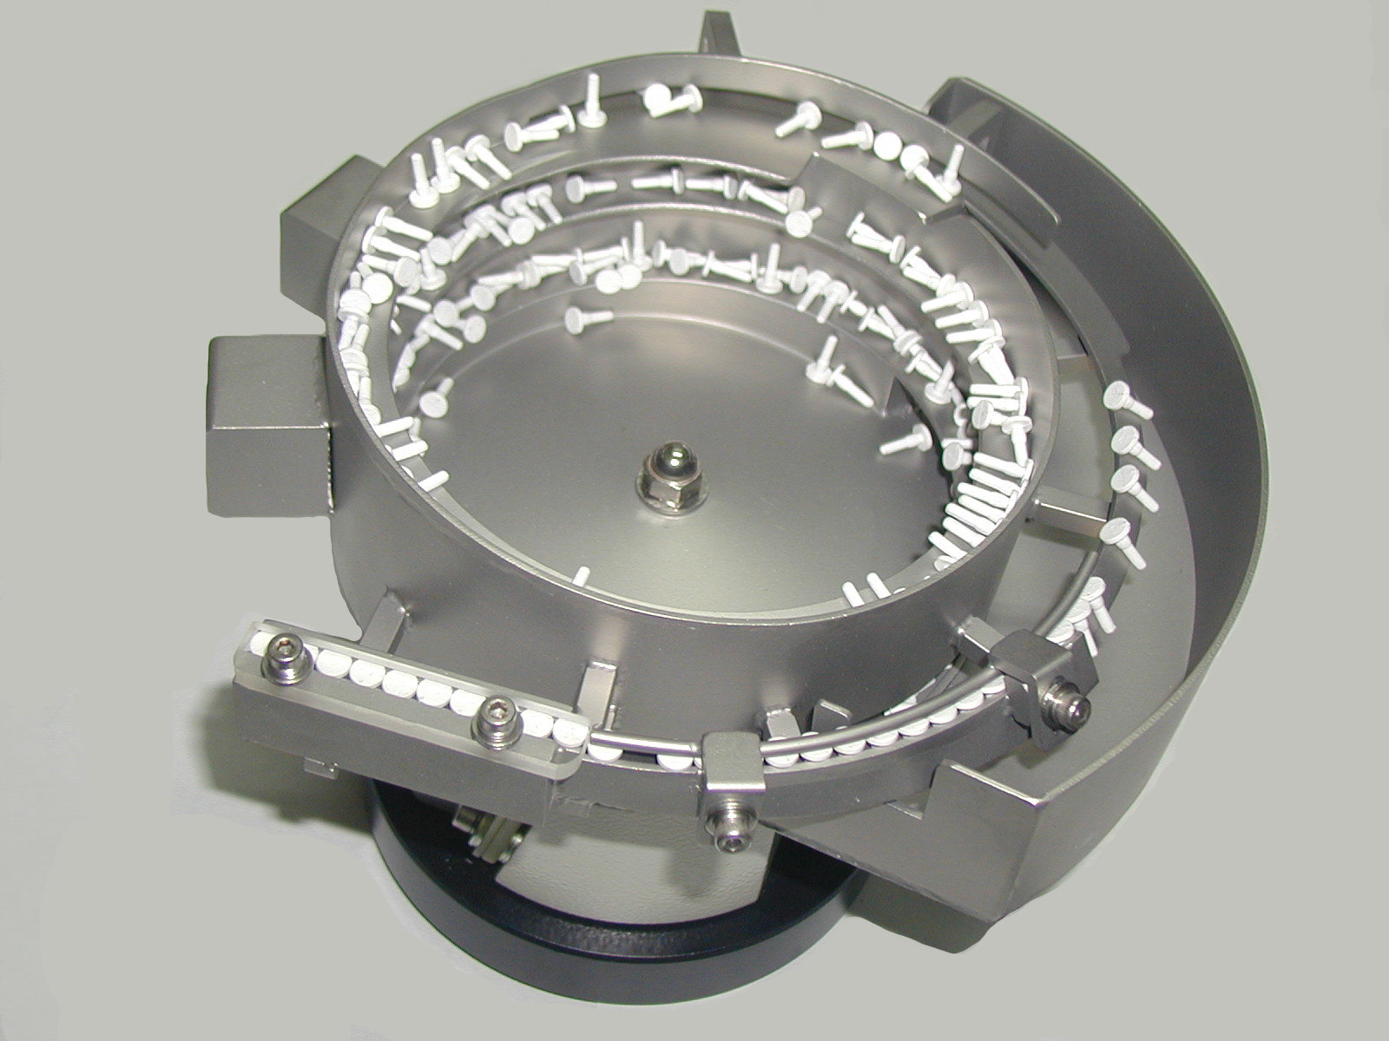
Part Presentation Methods
Bowl Feeder

Slide 30
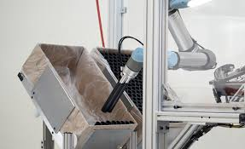
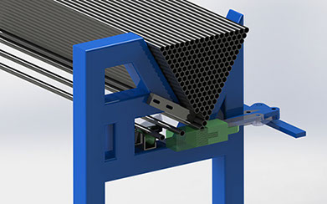
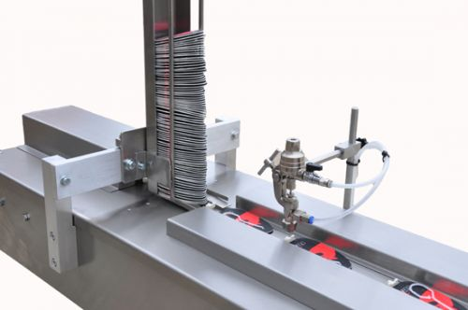
Magazine Feeders and Tray Feeder
Magazine Feeders
Tray

Slide 31
THANK YOU
The presenter is grateful to the authors of the following textbooks.
Industrial Robotics - Mikell P. Groover
Fundamentals of Robotics – Robert Schilling
Introduction to Robotics Analysis, Control, Applications Saeed B. Niku

